Slide 1


ENVIRONMENTAL POLLUTION
ENV 103

Slide 2
Environmental pollutions
Any alteration to air, water, soil or food that threatens the health, survival capability of humans or other living organisms, is called pollution.
Pollution is a global problem.

Slide 3
Causes of pollution
Natural
Volcanic eruptions
Soil erosion/ sediment transport
Dust storms
Tsunami
Man made
Domestic
Industrial
Agricultural
Mining

Slide 4
Types of pollution
Water pollution
Surface water
Ground water
Marine water
Soil or land pollution
Air pollution
Noise pollution

Slide 5
Water pollution
Water pollution refers to degradation of water quality.
Water in domestic uses must be free from constituents harmful to health. It should taste and smell good. It should not damage household appliances.
Water quality for industrial processes varies widely depending on the process. Some requires distilled water also.
Water pollution can occur as
Surface water pollution
Ground water pollution
Marine pollution

Slide 6
Some sources of water pollution
Surface water
Industrial effluent
Urban runoff
Agricultural runoff
Accidental spills of chemicals
Sediments.
Sewage.
Mining activity.
Temperature.
Groundwater
Leaks from waste disposal site
Saltwater intrusion into coastal aquifers
Seepage from mines and septic systems
Seepage from pesticides
Seepage from accidental spills
Seepage from polluted stream

Slide 7
Major categories of water pollution
Infectious agents: disease causing agents or pathogens, including bacteria, viruses, protozoa, parasites. These come from raw sewage and animal waste and they may be responsible for 80% of the disease in the developing countries.
Water soluble inorganic chemicals: acid, salts and metals. Make water unfit to consume and use for irrigation. Also can harm organism.

Slide 8
Organic chemicals: including oil, gasoline, plastics, pesticides and detergents. Present health risk to human and other organisms.
Plant nutrients: nitrates, phosphates, ammonium… from fertilizer mostly.
Sediments: mud, silt , sand. disrupt photosynthesis and bad for aquatic animals.
Heat: from cooling water for power plants and other industrial plants also affect aquatic lives directly.

Slide 9
Causes of surface water pollution
Uncontrolled discharge of waste water from agricultural land
Discharge of domestic waste water
Industrial waste
Acid rain through air pollution is also one of the causes of surface water pollution.
Decaying of organic matters into water bodies
Salt water intrusion in ground water
Leaching of chemicals
Wash down of components of volcanic eruptions

Slide 10
Ground water pollution
Domestic and industrial waste water pollutes the ground water.
Pesticides used in agricultural activities enter the ground water through irrigation water.

Slide 11
Marine pollution
Pollutants | Sources | Impacts
sediments | Deforestation, soil erosion, mining and farming | Blocks water flows and coastal ecosystems, clogs gills of fish
Pathogenic organisms | Sewage and livestock wastes | Contaminates coastal swimming places and seafood, spreading diseases
Litter, specially plastics | Disposed by people and plastic industry, thrown overboard from ships | Pollutes the water and beach areas
Oil | industries, ships and oil tankers | Kill sea fish and causes diseases in marine life
Radioactive waste | Discharge from nuclear power stations, reprocessing plants etc. | Causes diseases in marine life
Toxic waste (heavy metal and chemicals | Metals from mining and industries, pesticides from farms, discharge water from cities | Poisons marine life and contaminates sea food

Slide 12
Coastal/marine pollution: why should we care
About half of our population live within 200 km of the coast
We eat at least 15 lbs. of seafood per person each year
Just about everything bought & sold goes through ports in cargo ships
90% of ocean species live in continental shelf close to land. Each one play vital role for balance of the nature.
17% of our oil and 25% natural gas come from offshore

Slide 13
Effects of Water Pollution
Kills life that inhabits water-based ecosystems. Dead fish, birds, dolphins, and many other animals often found on beaches, killed by pollutants in their habitat.
Pollution disrupts the natural food chain as well. Pollutants such as lead and cadmium are eaten by tiny animals. Later, these animals are consumed by fish and shellfish, and the food chain continues to be disrupted at all higher levels.
- Eventually, humans are affected by this process as well. People can get diseases such as hepatitis by eating seafood that has been poisoned.
- Drinking polluted water can cause cholera or typhoid infections, along with diarrhea.

Slide 14
Measures to control water pollution
Pollution can be reduced by providing suitable facilities for collection, treatment and disposal of domestic waste.
Adopting modern technologies in industries that use less water.
Reusing and recycling industrial waste water.
Preventing wild dumping of solid and liquid waste on land.
Proving proper sanitation facilities at urban and rural areas.

Slide 15
Land or soil pollution
Dumping of solid wastes and waste water alter the structure, density, fertility of the soil and kill the microorganisms that exist in the land mass. Land pollution not only makes the soil unfit for use also become a source of ground water pollution.

Slide 16
Causes of land pollution
Discharge of liquid effluents from domestic and industrial activities on land
Dumping of solid refuse resulting from domestic, industrial, agricultural and health care activities
Mining activities
Agricultural activities

Slide 17
Effects of Land Pollution
Risk of seeping into the ground water causing contamination – affect plant & animal
Runoff from contaminated land can lead to water pollution
Land may become unfit for crop production
Toxins may contaminate food chain & ultimately enter human body causing disease

Slide 18
Air pollution
Air pollution is the introduction of chemicals, particulate matter, or biological materials into the atmosphere that cause harm or discomfort to humans or other living organisms, or cause damage to the natural environment or built environment.

Slide 19
Sources of air pollution
Stationary sources
Those have a relatively fixed location
Mobile sources
Emitters of air pollutants that move from place to place while yielding emissions. These includes automobiles , trucks, buses, aircrafts, ships and trains.
Natural sources
Emission of natural gases
Volcanic eruptions
Decomposition of organic matter
Dust storms
Forest fires
Man-made sources
Industrial activity
Construction activity
Mining activity
automobiles

Slide 20
Causes of air pollution
Burning fossil fuels in power stations and exhaust fumes from cars, trucks and buses.
Waste burnt from chemical and other industries
Bare soil in agricultural areas picked up and carried by the wind
Increased use of automobiles
Increased use of chemicals, especially CFCs

Slide 21
Effects of air pollution
Reduced visibility
Poor air quality
Formation of acid rain
Increase the earth’s temperature. Greenhouse gases are another source of air pollution.
Rising sea levels
Depletes the ozone layer in the stratosphere, leading to ozone holes
More heat radiated from the surface

Slide 22
Effects of air pollution continued…
Health problem particularly asthma, bronchitis and other respiratory problems
Increased risk of cancer in people, especially skin cancer
Increased acidity in lakes leading to death of fish and plant life
Increased acidity in soils reducing crop yield and killing trees
Changes in world weather (more storm and drought)
Less food supply, in extreme cases leading to famine

Slide 23
Acid Rain
Acid rain encompasses both wet(rain, snow, fog) and dry acidic depositions that occur in areas where major emissions of sulfur oxides (SO_{X}) and nitrogen oxides (NOx) result from burning fossil fuels.
Pure rain fall has a pH about 5.6 where 1 is highly acid and 7 is neutral. Acid rain is defined as precipitation in which the pH is below 5.6.
Acid rain damages not only forests and lakes but also many building materials, including steel, paint, plastics, cement, galvanized steel and several type of rock, especially limestone, sandstone and marble.

Slide 24
Smog
There are two major types of smog.
Photochemical smog which is sometimes called L.A. type smog or brown air. Solar radiation is particularly important for the formation of photochemical smog. It involves both NO and hydrocarbons. The development of these type of smog is directly related to automobiles use.
Sulfurous smog which is sometimes referred to as London-type smog, grey air or industrial smog. Sulfurous smog is produced primarily by burning coal or oil at large power plants. Sulfur oxides and particulates combined under certain meteorological conditions to produce a concentrated sulfurous smog.

Slide 25
Noise pollution
Sound is a physical phenomenon recognized as a physiological response by the hearing organ. Sound is a series of alternative waves traveling in a medium such as air from a vibrating body.
Noise can be defined as disturbing sound. It is an undesirable phenomenon and considered as an environmental pollutant.

Slide 26
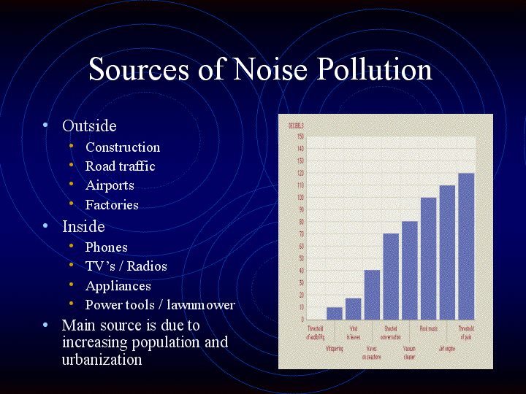

Slide 27
Effects of Noise pollution
Any unwanted sound that our ears have not been built to filter can cause problems within the body. Our ears can take in a certain range of sounds without getting damaged.
Constant exposure to loud levels of noise can easily result in the damage of our eardrums and loss of hearing, causing deafness
Excessive noise pollution in working areas such as offices, construction sites, bars and even in our homes can influence psychological health.
Studies show that the occurrence of aggressive behavior, disturbance of sleep, constant stress, fatigue, depression, anxiety, hysteria and hypertension in humans can be linked to excessive noise levels.
Noise pollution can cause headaches, high blood pressure, respiratory problems, racing pulse
Noise affects brain responses and people’s ability to focus, which can lead to low-performance levels over time.
Blood pressure levels, cardiovascular disease, and stress-related heart problems are on the rise.
High decibel noise can put trouble and affect free communication between people.

Slide 28
THANK YOU

